Slide 1
Pollen grain development
iDiagram Activity
Diagram from New Senior Biology by Scott & Maume, Publisher: Folens

Slide 2
Make your selection
CLICK HERE
to identify
PARTS
CLICK HERE
to identify
FUNCTIONS

Slide 3
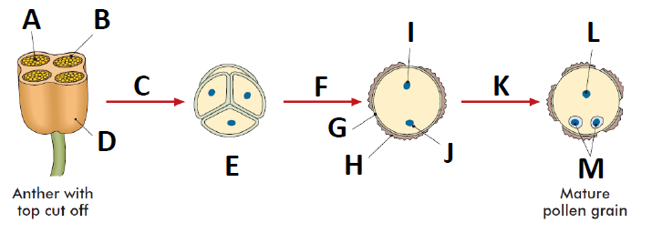
Name the part labelled A in the diagram
Four haploid microspores
Microspore mother cell
Pollen sac
Generative nucleus
Mitosis
Tapetum
Inner coat
Meiosis
Outer coat
Tube cell nucleus
Male gametes
Pollen grains
Tube nucleus

Slide 4
CONGRATULATIONS
Please CLICK on
THIS BOX
for the Next Question

Slide 5
Name the part labelled B in the diagram
Four haploid microspores
Microspore mother cell
Pollen sac
Generative nucleus
Mitosis
Tapetum
Inner coat
Meiosis
Outer coat
Tube cell nucleus
Male gametes
Pollen grains
Tube nucleus

Slide 6
CONGRATULATIONS
Please CLICK on
THIS BOX
for the Next Question

Slide 7
Name the type of cell division that occurs at C
Four haploid microspores
Microspore mother cell
Pollen sac
Generative nucleus
Mitosis
Tapetum
Inner coat
Meiosis
Outer coat
Tube cell nucleus
Male gametes
Pollen grains
Tube nucleus

Slide 8
CONGRATULATIONS
Please CLICK on
THIS BOX
for the Next Question

Slide 9
Name the part labelled D in the diagram
Four haploid microspores
Microspore mother cell
Pollen sac
Generative nucleus
Mitosis
Tapetum
Inner coat
Meiosis
Outer coat
Tube cell nucleus
Male gametes
Pollen grains
Tube nucleus

Slide 10
CONGRATULATIONS
Please CLICK on
THIS BOX
for the Next Question

Slide 11
Name the cells formed here at E
Four haploid microspores
Microspore mother cell
Pollen sac
Generative nucleus
Mitosis
Tapetum
Inner coat
Meiosis
Outer coat
Tube cell nucleus
Male gametes
Pollen grains
Tube nucleus

Slide 12
CONGRATULATIONS
Please CLICK on
THIS BOX
for the Next Question

Slide 13
These cells mature to form F
Four haploid microspores
Microspore mother cell
Pollen sac
Generative nucleus
Mitosis
Tapetum
Inner coat
Meiosis
Outer coat
Tube cell nucleus
Male gametes
Pollen grains
Tube nucleus

Slide 14
CONGRATULATIONS
Please CLICK on
THIS BOX
for the Next Question

Slide 15
Name the part labelled G in the diagram
Four haploid microspores
Microspore mother cell
Pollen sac
Generative nucleus
Mitosis
Tapetum
Inner coat
Meiosis
Outer coat
Tube cell nucleus
Male gametes
Pollen grains
Tube nucleus

Slide 16
CONGRATULATIONS
Please CLICK on
THIS BOX
for the Next Question

Slide 17
Name the part labelled H in the diagram
Four haploid microspores
Microspore mother cell
Pollen sac
Generative nucleus
Mitosis
Tapetum
Inner coat
Meiosis
Outer coat
Tube cell nucleus
Male gametes
Pollen grains
Tube nucleus

Slide 18
CONGRATULATIONS
Please CLICK on
THIS BOX
for the Next Question

Slide 19
Name the part labelled I in the diagram
Four haploid microspores
Microspore mother cell
Pollen sac
Generative nucleus
Mitosis
Tapetum
Inner coat
Meiosis
Outer coat
Tube cell nucleus
Male gametes
Pollen grains
Tube nucleus

Slide 20
CONGRATULATIONS
Please CLICK on
THIS BOX
for the Next Question

Slide 21
Name the part labelled J in the diagram
Four haploid microspores
Microspore mother cell
Pollen sac
Generative nucleus
Mitosis
Tapetum
Inner coat
Meiosis
Outer coat
Tube cell nucleus
Male gametes
Pollen grains
Tube nucleus

Slide 22
CONGRATULATIONS
Please CLICK on
THIS BOX
for the Next Question

Slide 23
Generative nucleus divides by K
Four haploid microspores
Microspore mother cell
Pollen sac
Generative nucleus
Mitosis
Tapetum
Inner coat
Meiosis
Outer coat
Tube cell nucleus
Male gametes
Pollen grains
Tube nucleus

Slide 24
CONGRATULATIONS
Please CLICK on
THIS BOX
for the Next Question

Slide 25
Name the part labelled L in the diagram
Four haploid microspores
Microspore mother cell
Pollen sac
Generative nucleus
Mitosis
Tapetum
Inner coat
Meiosis
Outer coat
Tube cell nucleus
Male gametes
Pollen grains
Tube nucleus

Slide 26
CONGRATULATIONS
Please CLICK on
THIS BOX
for the Next Question

Slide 27
Name the part labelled M in the diagram
Four haploid microspores
Microspore mother cell
Pollen sac
Generative nucleus
Mitosis
Tapetum
Inner coat
Meiosis
Outer coat
Tube cell nucleus
Male gametes
Pollen grains
Tube nucleus

Slide 28
CONGRATULATIONS
Please CLICK on
THIS BOX
for the Next Question

Slide 29
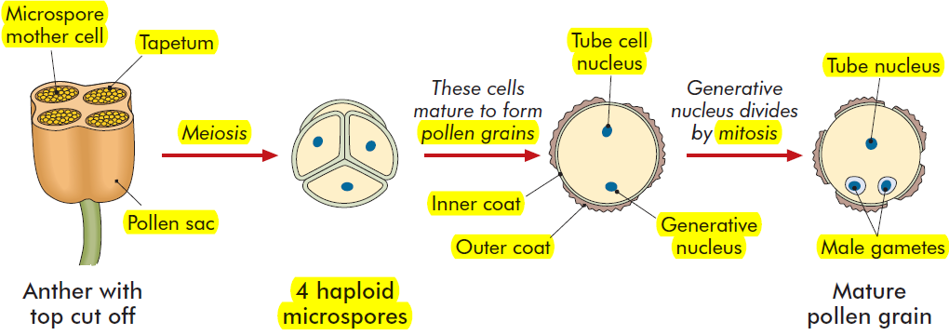
Pollen grain development diagram
CLICK HERE

Slide 30
CONGRATULATIONS You’re Brilliant
Click on this box to REPEAT this activity or press ESC to quit

Slide 31
What are the megaspore mother cells?
A cell division of gamete or spore producing cells
Method of cell division by cells not involved in the formation of gametes
Cells in the pollen sacs from which pollen grains are produced
Nutritive cells surrounding the pollen sacs
Divide by mitosis after pollination to form two male gamete nuclei
Produce pollen grains
Produce the male gamete nuclei
Grows down through the stigma, style, and into the ovule, followed by the two male gamete nuclei to enter the embryo sac through the micropyle
To join with female egg at fertilisation

Slide 32
CONGRATULATIONS
Please CLICK on
THIS BOX
for the Next Question

Slide 33
What is the function of the tapetum?
A cell division of gamete or spore producing cells
Method of cell division by cells not involved in the formation of gametes
Cells in the pollen sacs from which pollen grains are produced
Nutritive cells surrounding the pollen sacs
Divide by mitosis after pollination to form two male gamete nuclei
Produce pollen grains
Produce the male gamete nuclei
Grows down through the stigma, style, and into the ovule, followed by the two male gamete nuclei to enter the embryo sac through the micropyle
To join with female egg at fertilisation

Slide 34
CONGRATULATIONS
Please CLICK on
THIS BOX
for the Next Question

Slide 35
What is meiosis?
A cell division of gamete or spore producing cells
Method of cell division by cells not involved in the formation of gametes
Cells in the pollen sacs from which pollen grains are produced
Nutritive cells surrounding the pollen sacs
Divide by mitosis after pollination to form two male gamete nuclei
Produce pollen grains
Produce the male gamete nuclei
Grows down through the stigma, style, and into the ovule, followed by the two male gamete nuclei to enter the embryo sac through the micropyle
To join with female egg at fertilisation

Slide 36
CONGRATULATIONS
Please CLICK on
THIS BOX
for the Next Question

Slide 37
What is the function of the pollen sac?
A cell division of gamete or spore producing cells
Method of cell division by cells not involved in the formation of gametes
Cells in the pollen sacs from which pollen grains are produced
Nutritive cells surrounding the pollen sacs
Divide by mitosis after pollination to form two male gamete nuclei
Produce pollen grains
Produce the male gamete nuclei
Grows down through the stigma, style, and into the ovule, followed by the two male gamete nuclei to enter the embryo sac through the micropyle
To join with female egg at fertilisation

Slide 38
CONGRATULATIONS
Please CLICK on
THIS BOX
for the Next Question

Slide 39
What is the function of the pollen grains?
A cell division of gamete or spore producing cells
Method of cell division by cells not involved in the formation of gametes
Cells in the pollen sacs from which pollen grains are produced
Nutritive cells surrounding the pollen sacs
Divide by mitosis after pollination to form two male gamete nuclei
Produce pollen grains
Produce the male gamete nuclei
Grows down through the stigma, style, and into the ovule, followed by the two male gamete nuclei to enter the embryo sac through the micropyle
To join with female egg at fertilisation

Slide 40
CONGRATULATIONS
Please CLICK on
THIS BOX
for the Next Question

Slide 41
What happens to the tube cell nucleus?
A cell division of gamete or spore producing cells
Method of cell division by cells not involved in the formation of gametes
Cells in the pollen sacs from which pollen grains are produced
Nutritive cells surrounding the pollen sacs
Divide by mitosis after pollination to form two male gamete nuclei
Produce pollen grains
Produce the male gamete nuclei
Grows down through the stigma, style, and into the ovule, followed by the two male gamete nuclei to enter the embryo sac through the micropyle
To join with female egg at fertilisation

Slide 42
CONGRATULATIONS
Please CLICK on
THIS BOX
for the Next Question

Slide 43
What happens to the generative nucleus?
A cell division of gamete or spore producing cells
Method of cell division by cells not involved in the formation of gametes
Cells in the pollen sacs from which pollen grains are produced
Nutritive cells surrounding the pollen sacs
Divide by mitosis after pollination to form two male gamete nuclei
Produce pollen grains
Produce the male gamete nuclei
Grows down through the stigma, style, and into the ovule, followed by the two male gamete nuclei to enter the embryo sac through the micropyle
To join with female egg at fertilisation

Slide 44
CONGRATULATIONS
Please CLICK on
THIS BOX
for the Next Question

Slide 45
What is mitosis?
A cell division of gamete or spore producing cells
Method of cell division by cells not involved in the formation of gametes
Cells in the pollen sacs from which pollen grains are produced
Nutritive cells surrounding the pollen sacs
Divide by mitosis after pollination to form two male gamete nuclei
Produce pollen grains
Produce the male gamete nuclei
Grows down through the stigma, style, and into the ovule, followed by the two male gamete nuclei to enter the embryo sac through the micropyle
To join with female egg at fertilisation

Slide 46
CONGRATULATIONS
Please CLICK on
THIS BOX
for the Next Question

Slide 47
What happens to the tube nucleus?
A cell division of gamete or spore producing cells
Method of cell division by cells not involved in the formation of gametes
Cells in the pollen sacs from which pollen grains are produced
Nutritive cells surrounding the pollen sacs
Divide by mitosis after pollination to form two male gamete nuclei
Produce pollen grains
Produce the male gamete nuclei
Grows down through the stigma, style, and into the ovule, followed by the two male gamete nuclei to enter the embryo sac through the micropyle
To join with female egg at fertilisation

Slide 48
CONGRATULATIONS
Please CLICK on
THIS BOX
for the Next Question

Slide 49
What is the function of the male gametes?
A cell division of gamete or spore producing cells
Method of cell division by cells not involved in the formation of gametes
Cells in the pollen sacs from which pollen grains are produced
Nutritive cells surrounding the pollen sacs
Divide by mitosis after pollination to form two male gamete nuclei
Produce pollen grains
Produce the male gamete nuclei
Grows down through the stigma, style, and into the ovule, followed by the two male gamete nuclei to enter the embryo sac through the micropyle
To join with female egg at fertilisation

Slide 50
CONGRATULATIONS
Please CLICK on
THIS BOX
for the Next Question

Slide 51
Pollen grain development diagram
CLICK HERE

Slide 52
Incorrect
Please CLICK on
THIS BOX
to Try Again

