Slide 1
Flowering Plant – External Structure
iDiagram Activity
Diagram from New Senior Biology by Scott & Maume, Publisher: Folens

Slide 2
Make your selection
CLICK HERE
to identify
PARTS
CLICK HERE
to identify
FUNCTIONS

Slide 3
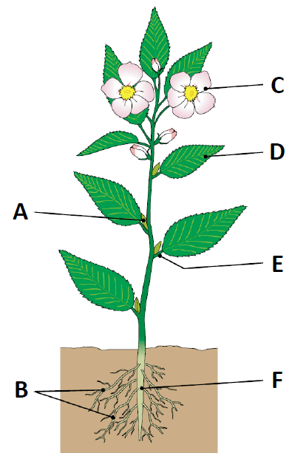
Name the part labelled A in the diagram
Bud
Flower
Lateral roots
Leaf
Petiole
Root

Slide 4
CONGRATULATIONS
Please CLICK on
THIS BOX
for the Next Question

Slide 5
Name the part labelled B in the diagram
Bud
Flower
Lateral roots
Leaf
Petiole
Root

Slide 6
CONGRATULATIONS
Please CLICK on
THIS BOX
for the Next Question

Slide 7
Name the part labelled C in the diagram
Bud
Flower
Lateral roots
Leaf
Petiole
Root

Slide 8
CONGRATULATIONS
Please CLICK on
THIS BOX
for the Next Question

Slide 9
Name the part labelled D in the diagram
Bud
Flower
Lateral roots
Leaf
Petiole
Root

Slide 10
CONGRATULATIONS
Please CLICK on
THIS BOX
for the Next Question

Slide 11
Name the part labelled E in the diagram
Bud
Flower
Lateral roots
Leaf
Petiole
Root

Slide 12
CONGRATULATIONS
Please CLICK on
THIS BOX
for the Next Question

Slide 13
Name the part labelled F in the diagram
Bud
Flower
Lateral roots
Leaf
Petiole
Root

Slide 14
CONGRATULATIONS
Please CLICK on
THIS BOX
for the Next Question

Slide 15
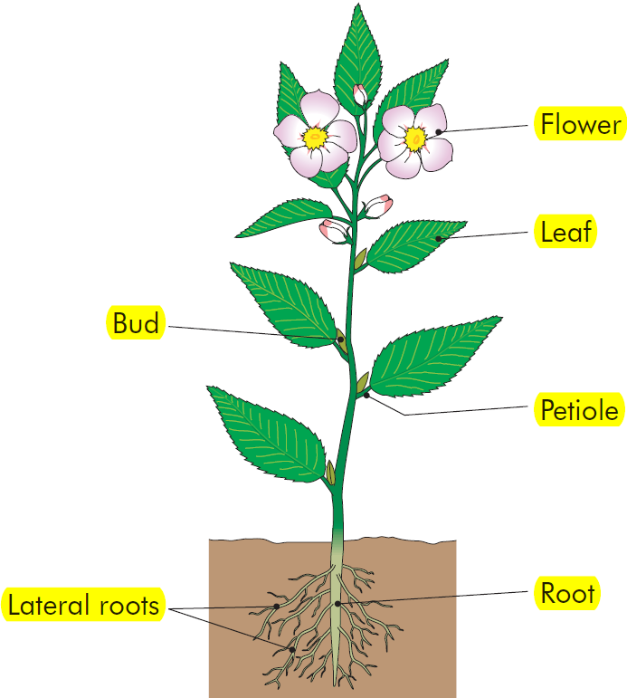
Flowering Plant – External Structure
CLICK HERE

Slide 16
CONGRATULATIONS You’re Brilliant
Click on this box to REPEAT this activity or press ESC to quit

Slide 17
What is the function of the bud?
Anchorage, absorption and sometimes storage
Grow into a shoot, leaf or flower
Involved in photosynthesis, transpiration and respiration
Reproductive shoot of plant

Slide 18
CONGRATULATIONS
Please CLICK on
THIS BOX
for the Next Question

Slide 19
What is the function of the flower?
Anchorage, absorption and sometimes storage
Grow into a shoot, leaf or flower
Involved in photosynthesis, transpiration and respiration
Reproductive shoot of plant

Slide 20
CONGRATULATIONS
Please CLICK on
THIS BOX
for the Next Question

Slide 21
What is the function of the leaf?
Anchorage, absorption and sometimes storage
Grow into a shoot, leaf or flower
Involved in photosynthesis, transpiration and respiration
Reproductive shoot of plant

Slide 22
CONGRATULATIONS
Please CLICK on
THIS BOX
for the Next Question

Slide 23
What is the function of the root?
Anchorage, absorption and sometimes storage
Grow into a shoot, leaf or flower
Involved in photosynthesis, transpiration and respiration
Reproductive shoot of plant

Slide 24
CONGRATULATIONS
Please CLICK on
THIS BOX
for the Next Question

Slide 25
Flowering Plant – External Structure
CLICK HERE

Slide 26
Incorrect
Please CLICK on
THIS BOX
to Try Again

